Slide 1
Chapter 7 Connectors Presentation
Use the list of connectors on Page 155 in the Video Textbook
Create a prezi, powerpoint, or google slides document
Slide 1 – Name and Title
Slides 2 – 29
Name of connector
Picture of connector
Pictures can be obtained from the internet or the book powerpoint
Description of connector and how it is normally used
Upload the finished document to schoology
An example of a connector slide is on the next page

Slide 2
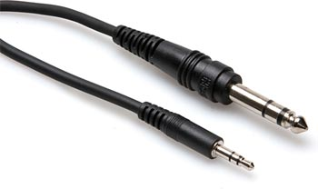
1/8th inch connector
A plug and socket widely used for analog audio signals
Ex. Headphone jacks on iPods, tablets, and portable DVD players

